Slide 1
CGB1121 – PYTHON PROGRAMMING END SEMESTER REVIEW - APRIL/MAY 2026
Department of Computer Science and Engineering
Academic Year: 2025 – 2026 (Even Semester)
Batch No. :07
Register Number :927625BCS064 , 927625BCS116
Name :KANISHKA.A.K,PATHMASRI.V.M
Year : I
Semester : II
Section : CSE-B
Date :04.06.2026

Slide 2
Title of the Project
PAYROLL PROCESSING SYSTEM

Slide 3
Abstract
The Payroll Processing System is a Python-based application developed to automate the calculation of employee salaries in an accurate and efficient manner. Manual salary computation can lead to errors and consume significant time, so this system provides a structured and reliable solution using Python programming concepts. The application uses separate functions to calculate basic pay, allowances, deductions, and net salary. By dividing the program into modular components, the system ensures better organization, easy maintenance, and improved accuracy. Allowances and deductions are calculated independently before determining the final net pay. The system takes employee details as input, processes all salary components step by step, and generates the final salary output. This project demonstrates the practical use of functions, arithmetic operations, and logical structures in Python to build a simple and effective payroll management system.

Slide 4
Abstract with CO/PO Mapping
Abstract | CO | POs | PSO
The Payroll Processing System is a Python-based program designed to automate employee salary calculation. It uses separate functions to compute basic pay, allowances, deductions, and net salary, ensuring accuracy and clarity. The system takes employee details as input and generates the final salary after processing all components. This project demonstrates the use of modular programming in Python to create a simple, reliable, and maintainable payroll management solution. | CO1 CO2 CO3 CO4 | PO1 PO2 PO3 PO4 PO5 PO9 PO10 PO11 | PSO1 PSO2

Slide 5
Introduction
The Payroll Processing System is a Python-based application developed to automate and manage employee salary operations efficiently. In many organizations, payroll calculation is a time-consuming and error-prone task when done manually. This system helps in calculating employee salaries by considering basic pay, allowances, bonuses, overtime, and deductions such as tax and provident fund. The project is developed using core Python concepts like functions, loops, conditional statements, and file handling to store and process employee records. It ensures accuracy, reduces paperwork, saves time, and improves overall payroll management. This system is especially useful for small and medium-sized organizations to maintain structured and reliable salary records.

Slide 6
Python Programming - Concepts Used
1.Variables & Data Types
Store employee details and salary values
2. Conditional Statements (if–else)
Calculate tax, deductions, and salary conditions
3. Loops (for / while)
Process multiple employee records
4. Functions
Perform modular salary calculations
5. File Handling
Store and retrieve payroll data (CSV/TXT)
6. Data Structures (List / Dictionary)
Manage employee records efficiently
7. Object-Oriented Programming (Optional)
Create Employee or Payroll classes

Slide 7
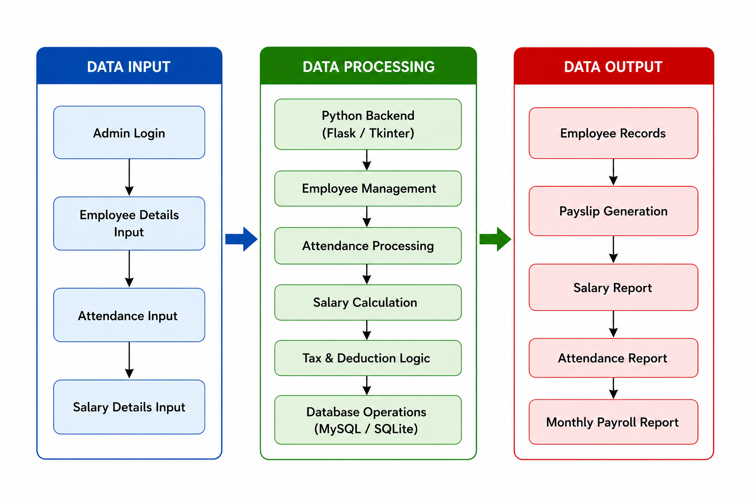
Proposed Architecture

Slide 8
Proposed Architecture - Description
Data Input :
The Data Input module collects employee details, attendance records, and salary information from the administrator for payroll processing.
Data Processing :
The Data Processing module uses the Python backend to manage employee data, process attendance, calculate salaries, apply tax and deduction rules, and store data in the database.
Data Output :
The Data Output module generates employee records, pay slips, salary reports, attendance reports, and monthly payroll reports for effective payroll management.

Slide 9
List of Modules
Employee Management Module
Salary Calculation Module
Allowances & Deductions Module
Tax & PF Management Module
Payroll Processing Module
Database/File Handling Module
Report & Payslip Generation Module
Security & Backup Module

Slide 10
Description of Modules
Employee Management Module – Manages employee details such as ID, name, designation, and salary structure.
Salary Calculation Module – Calculates basic pay, overtime, and gross salary.
Allowances & Deductions Module – Handles bonuses, allowances, tax, and other deductions.
Tax & PF Management Module – Computes income tax and provident fund contributions.
Payroll Processing Module – Generates net salary and final payroll records.
Database/File Handling Module – Stores and retrieves employee and payroll data.
Report & Pay slip Generation Module – Creates salary slips and payroll summary reports.
Security & Backup Module – Ensures data protection and maintains backup records.

Slide 11
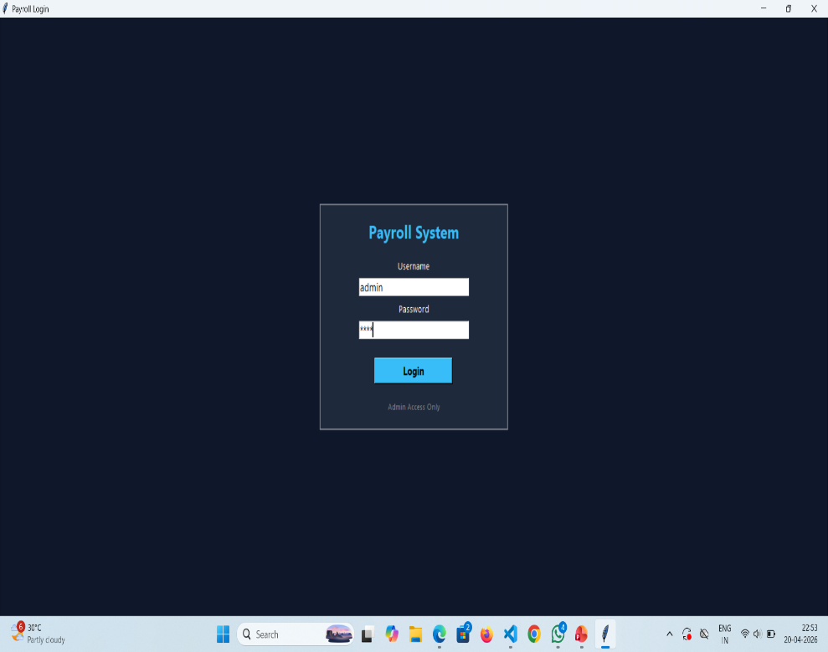
Results and Discussion
Output Screenshot:
Description:
Payroll System – Login Page
Used to login into the system
Admin enters username & password
If correct → system opens
If wrong → shows error
Keeps data secure
Technology: Python (Tkinter)

Slide 12
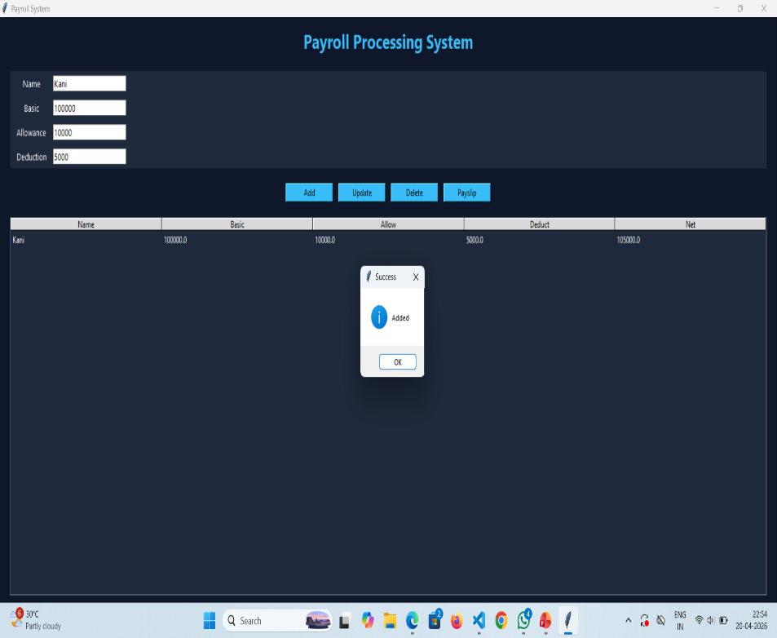
Results and Discussion(Cont..)
Output Screenshot:
Description:
This output shows the main interface of the Payroll Processing System. It allows the user to enter employee details such as name, basic salary, allowance, and deduction. The system provides options like Add, View, Update, Delete Employee, and Generate Pay slip, making it easy to manage employee payroll and calculate salaries.

Slide 13
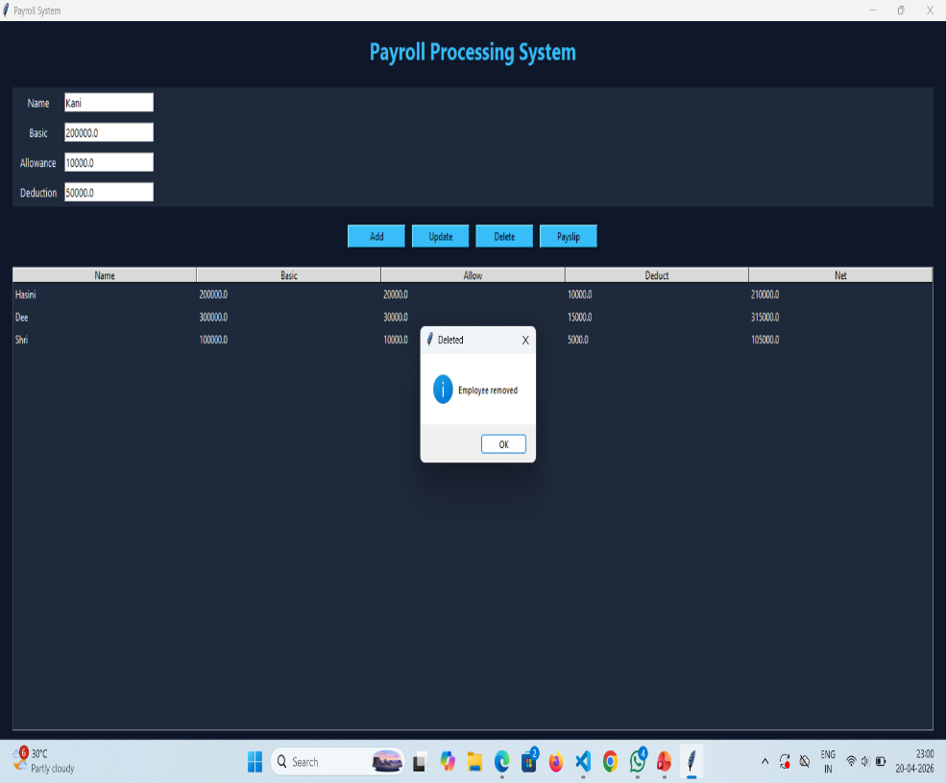
Results and Discussion(Cont..)
Output Screenshot:
Description:
The screenshot shows the output of a Payroll Processing System. The user enters employee details like name, basic salary, allowance, and deduction. The system calculates the net salary and displays it in a pay slip popup. Example: For Shri, the net salary is calculated as 43000.

Slide 14
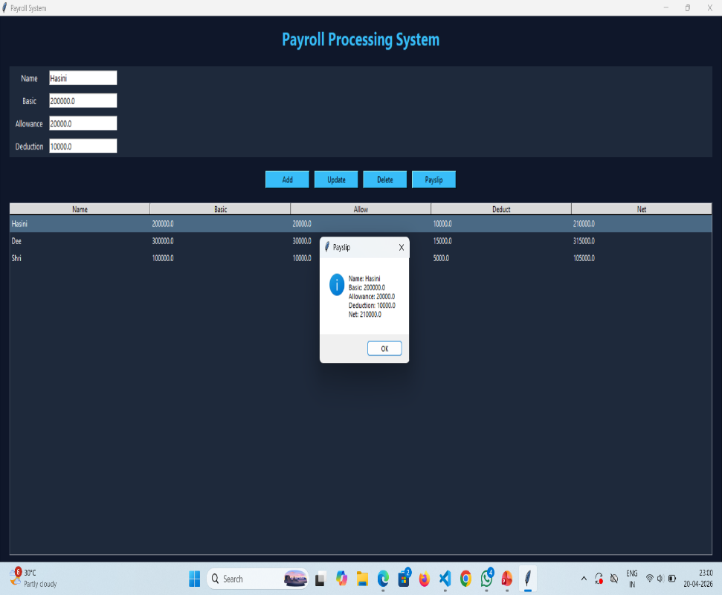
Results and Discussion(Cont..)
Output Screenshot:
Description:
The screenshot shows the employee list view of the Payroll Processing System. It displays the names of added employees (like Jeeva and Shri) in a list format. The user can select any employee and click the “View Selected” button to see their details.

Slide 15
Conclusion
The Payroll Processing System developed using Python provides an efficient and automated solution for managing employee payroll activities. The system simplifies payroll operations by maintaining employee records, processing attendance, calculating salaries, applying deductions, and generating pay slips and reports accurately. By reducing manual calculations and paperwork, the system improves efficiency, minimizes errors, and saves time. Overall, the project demonstrates how Python can be used to develop a reliable, user-friendly, and effective payroll management system for organizations.

Slide 16
Thank You
Any queries???

